Slide 1

PROJECT
Estimating Workation Price (per person)

Slide 2


Slide 3
Business Objective, Understanding And Approach
Business objective
With remote working becoming the preferred choice of many millennial workers, the concept of Workation is fast gaining popularity as it provides out of office experience encompassing both work time and leisure time.
Lots of websites provide different workation options for the users to choose from based on preferred destination location, the available amenities such as high-speed internet, a comfortable stay that too within the budget.
However it is challenging to find a good option for a given budget. To understand this problem further, a Travel and Hospitality Industry Client wants to predict the right price (per person) of the tour packages based on different factors.
Understanding
The problem had columns mainly consisting of text-based data.
We teased out the total number of destinations covered in each trip from the ‘Destination’ column and the total places seen in each trip from the ‘Sightseeing Places Covered’ column.
The ‘Itinerary’ column, helped to extract the total number of days covered in each trip.
‘Places Covered’ was dropped as it was similar to ‘Destination’.

Slide 4
We understood that to predict the price for a person for a trip first we have to know to which place the person is interested to travel and how he wants to travel.
Approach
We started analyzing challenge with regular EDA (exploratory data analysis) and focused systematic encoding of categorical features using custom encoders.
We used Exploratory Data Analysis ( EDA) to understand the data in detail which helped us to implement different feature engineering techniques
Various date related variables were also derived using the Datetime Index attributes of the Pandas’ library.
Variables like the number of places covered, number of nights during the trip, number of sightseeing places were also calculated.

Slide 5
EDD :EXPLORATORY DATA DICTONARY
 | Variable Type | Min | Pc 1% | Pc 5% | Pc 25% | Pc 50% | Mean | Pc 75% | Pc 95% | Pc 99% | Max | % Missing values | % Unique values
Flight Stops | Numeric | 0.4 | 3.69 | 8.8 | 30.7 | 85.05 | 246.4 | 251 | 1015 | 2301 | 2263 | 0% | 53.03%
Meals | Numeric | 1.0 | 1.0 | 1.0 | 2.0 | 3.0 | 3.4 | 5.0 | 8.0 | 11.0 | 14.0 | 0% | 0.02%
Per person price | Numeric | 0.0 | 0.0 | 0.0 | 0.0 | 0.0 | 0.1 | 0.2 | 0.6 | 0.7 | 0.8 | 0% | 0.05%
 | Numeric | -6599 | -351.5 | 83.9 | 0.0 | 9.2 | 28.6 | 36.8 | 211 | 587 | 8399
 | Numeric | 1.0 | 1.1 | 1.32 | 2.61 | 7.7 | 26.4 | 24.4 | 111 | 286 | 933 | 0% | 32.66%

Slide 6
Feature Engineering
New columns | Description
No of places Travelled | We had created a separate column according to how many places that a package covers.
No of sight seeing places | We had created a separate column according to how many places that a package covers.
Travel Month | We had created a separate column according to which month they have travelled.
No of Airlines used | We had created a separate column according to Which how many number of airlines used to reach the destination in the package.

Slide 7
New columns | Description
Different Package Type | We had created a separate column according to the unique number of types in it to numeric values.
Different start city | We had created a separate column according to how many places that a package covers.
Cancellation types | We had created a separate column according to which month they have travelled.
No of Airlines used | We had created a separate column according to Which how many number of airlines used to reach the destination in the package.

Slide 8
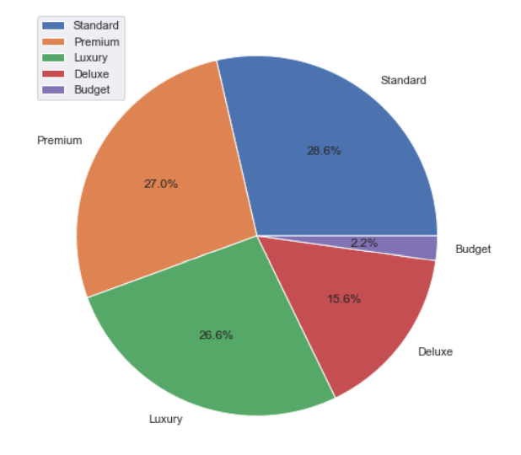

Slide 9
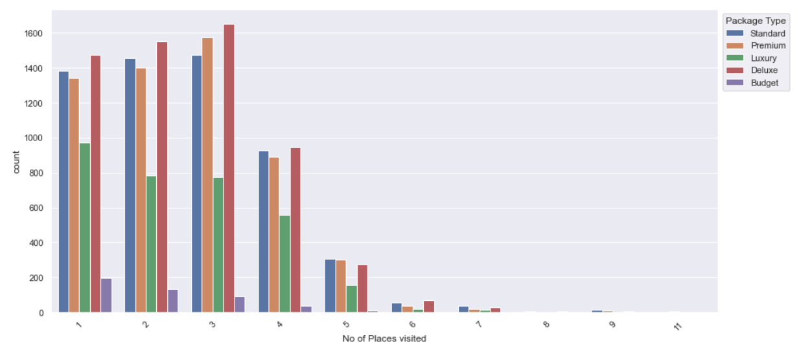

Slide 10
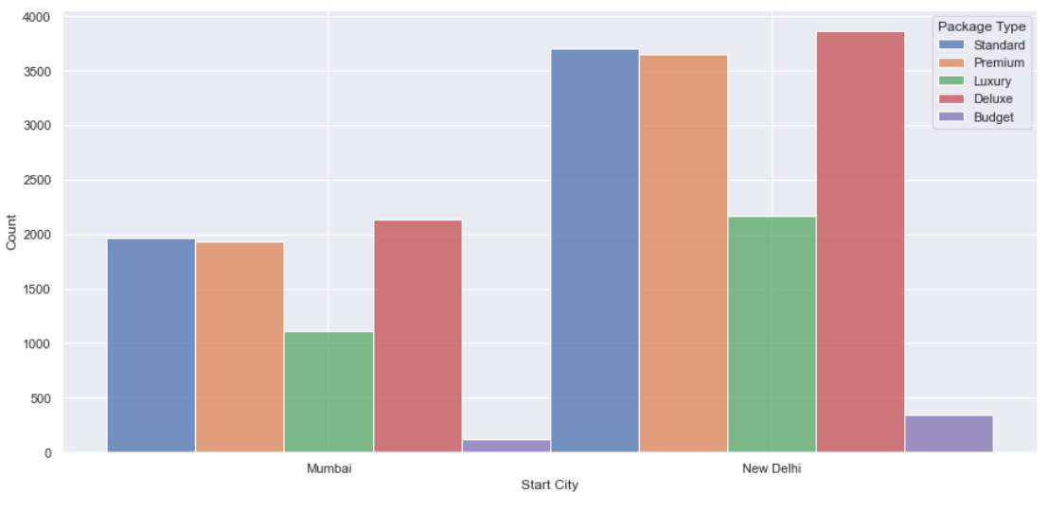

Slide 11
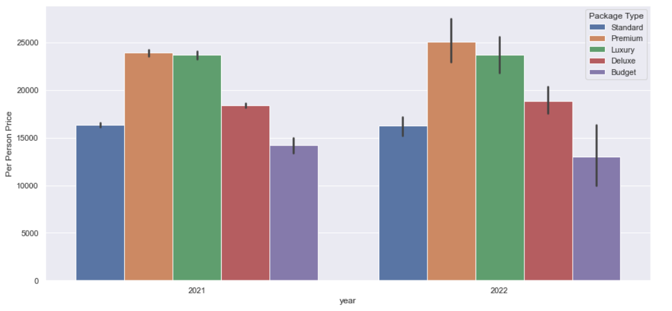

Slide 12
Important variable explanation to build our model
 | Correlation with price | Description
Package Type
No of Places Covered
No of Days Spent
Travel Month
No of Sightseeing Places
Start City
No of Air Lines Used

